Slide 1
Python's Core Data Structures
Presenter: Om Parkash

Slide 2
Agenda
More on Lists
Lists as Stack & Queue
List Comprehensions
Nested List Comprehensions
The del Statement
Tuples and Sequences

Slide 3
More on Lists
Lists: Mutable, ordered collections and hold, mixed data types.
Useful Methods:
append(value): Add element.
extend(iterable): Add multiple elements.
insert(index, value): Insert at specific position.
index(value): Find position of first occurrence.
count(value): Count occurrences.
sort(): In-place sorting.
reverse(): Reverse elements.

Slide 4

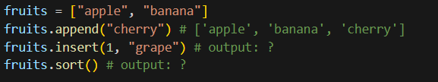
More on Lists
Example:

Slide 5
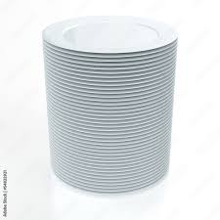
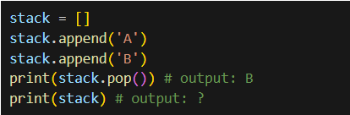
Lists as Stack (LIFO)
Stack = Last In, First Out
Operations:
append(): push item to top
pop(): Pop top item
Use Case: Undo operations, backtracking

Slide 6


Lists as Queue (FIFO)
Queue = First In, First Out
Queue Operations:
enqueue: append(item)
dequeue: pop(0) (removes first element)
Use Case: Task scheduling, BFS
Inefficiency Warning: pop(0) is O(n); prefer collections.deque for large data.

Slide 7
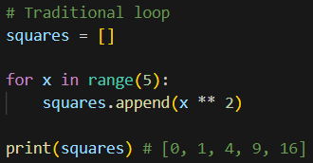
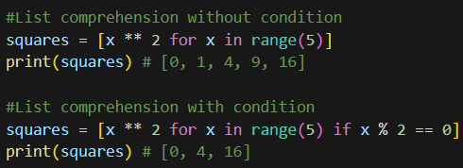
List Comprehensions
Concise syntax for creating lists
Syntax: [expression for item in iterable if condition]
Use Case: Faster and clearer than loops

Slide 8

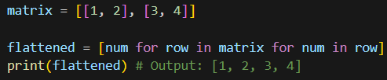
Nested List Comprehensions
Create complex lists or for 2D structures (e.g., matrices):
Use Cases: Matrix operations, data transformations, Flattening matrices or creating grids
Note: Powerful, but can reduce readability.

Slide 9
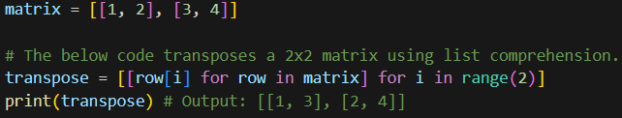

Nested List Comprehensions
Example:

Slide 10
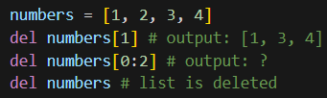
The del Statement
Purpose: Remove elements, slices, or variables.
Use to manage memory or clean up data.

Slide 11
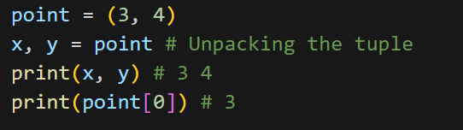
Tuples and Sequences
Tuples = Immutable sequences, ordered sequences, defined with ()
Syntax: (1,2,3) or 1,2,3
Use case: fixed data (e.g., coordinates)
Operations: Indexing, slicing, unpacking
Sequence Types: Lists, Tuples, Strings.
Tuples are faster than list

Slide 12
Summary
Lists: Dynamic and powerful
Stack/Queue: append/pop, deque
Comprehensions: Elegant list building
del: Remove data
Tuples: Immutable sequences

Slide 13
QUESTIONS?

Slide 14
Thank You!

